Slide 1
Help Wanted Online A real-time measure of job postings
July 2022
Office of Research Connecticut Department of Labor
Connecticut Department of Labor – Research Office 200 Folly Brook Blvd. Wethersfield, CT 06109
Help Wanted Online

Slide 2
What is HWOL?
The Conference Board Help Wanted Online® Data Series (HWOL) measures the number of new, first-time Online job postings and jobs reposted from the previous month for over 50,000 Internet job boards, corporate boards and smaller job sites that serve niche markets and smaller geographic areas.
Connecticut Department of Labor – Research Office 200 Folly Brook Blvd. Wethersfield, CT 06109
Help Wanted Online

Slide 3
Upcoming Release Dates
Monthly Report: Friday, August 12th, 2022 Weekly New Ads Report: Updated every Friday
Connecticut Department of Labor – Research Office 200 Folly Brook Blvd. Wethersfield, CT 06109
Help Wanted Online

Slide 4
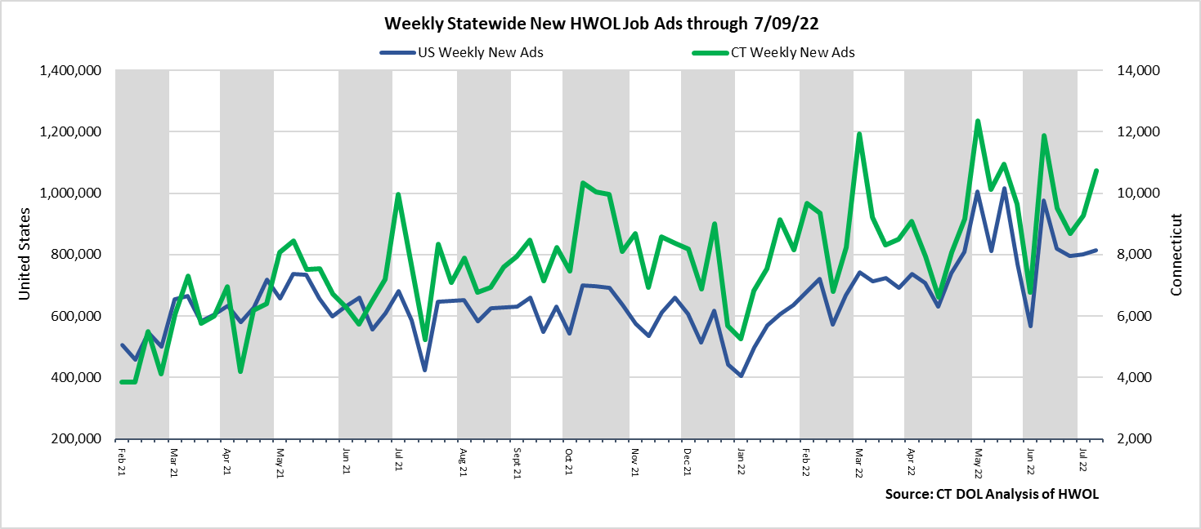
Statewide Weekly New Job Ads
Weekly New job postings was 6,847 during the week ending 7/09/22.
Connecticut Department of Labor – Research Office 200 Folly Brook Blvd. Wethersfield, CT 06109
Help Wanted Online

Slide 5
HWOL New Weekly Industry Job Ads – CT Statewide
Connecticut Department of Labor – Research Office 200 Folly Brook Blvd. Wethersfield, CT 06109
Help Wanted Online

Slide 6
Connecticut Department of Labor – Research Office 200 Folly Brook Blvd. Wethersfield, CT 06109
Help Wanted Online

Slide 7
Employers with the Most New Job Postings
Connecticut Department of Labor – Research Office 200 Folly Brook Blvd. Wethersfield, CT 06109
Help Wanted Online

Slide 8
Monthly HWOL Information
The following pages contain HWOL monthly data for June 2022. Monthly and weekly job ad information can be found here: https://www1.ctdol.state.ct.us/lmi/HWOL.asp
Connecticut Department of Labor – Research Office 200 Folly Brook Blvd. Wethersfield, CT 06109
Help Wanted Online

Slide 9
Statewide Highlights
- Total postings in Connecticut was 109,504 in June 2022, Up 3% from May 2022. -Industry sectors with the most job postings were Health Care and Social Assistance (22,150 postings), Finance and Insurance (10,501 posting), Retail Trade (10,294 postings), and Manufacturing (9,044 postings).
-Occupations with the most postings were Registered Nurses (4,922 postings), Retail Salespersons (3,043 postings), Wholesale & Manufacturing Sales Representatives (2,336 postings), and Supervisors of Retail Sales Workers (2,335).
Connecticut Department of Labor – Research Office 200 Folly Brook Blvd. Wethersfield, CT 06109
Help Wanted Online

Slide 10
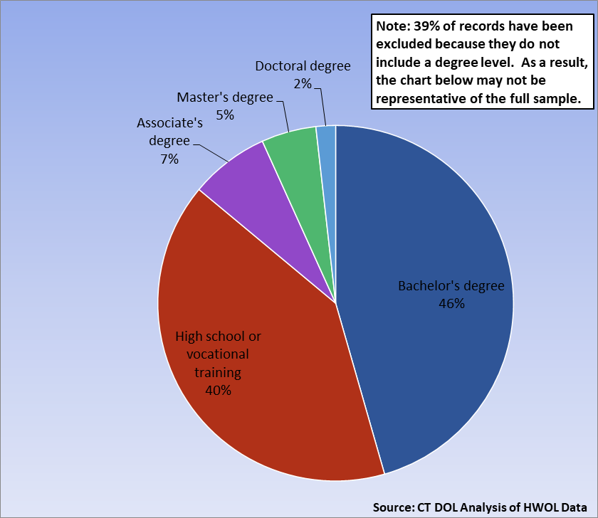
Connecticut Job Ads by Educational Requirements
Connecticut Department of Labor – Research Office 200 Folly Brook Blvd. Wethersfield, CT 06109
Help Wanted Online

Slide 11
Top Certifications in Connecticut Job Ads
Connecticut Department of Labor – Research Office 200 Folly Brook Blvd. Wethersfield, CT 06109
Help Wanted Online

Slide 12
Top Skills in Connecticut Job Ads
Connecticut Department of Labor – Research Office 200 Folly Brook Blvd. Wethersfield, CT 06109
Help Wanted Online

Slide 13
Top Skills by Industry in Connecticut Job Ads
Connecticut Department of Labor – Research Office 200 Folly Brook Blvd. Wethersfield, CT 06109
Help Wanted Online

Slide 14
Top Skills by Industry in Connecticut Job Ads (Continued)
Connecticut Department of Labor – Research Office 200 Folly Brook Blvd. Wethersfield, CT 06109
Help Wanted Online

Slide 15
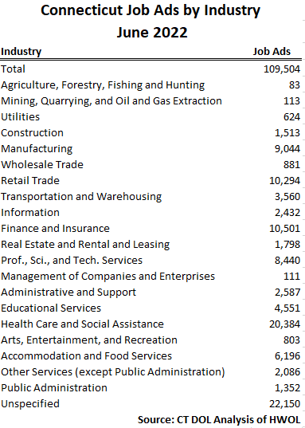
Connecticut Department of Labor – Research Office 200 Folly Brook Blvd. Wethersfield, CT 06109
Help Wanted Online

Slide 16
Connecticut Employers with the Most Job Ads
Connecticut Department of Labor – Research Office 200 Folly Brook Blvd. Wethersfield, CT 06109
Help Wanted Online

Slide 17
Connecticut Occupations with the Most Job Ads
Connecticut Department of Labor – Research Office 200 Folly Brook Blvd. Wethersfield, CT 06109
Help Wanted Online

Slide 18
Connecticut Job Ads by Industry and Major Occupational Group
Connecticut Department of Labor – Research Office 200 Folly Brook Blvd. Wethersfield, CT 06109
Help Wanted Online

Slide 19
Workforce Area Data
Workforce Area Highlights
Job Ads by Industry
Job Ads by Location
Employers With The Most Job Ads
Occupations With The Most Job Ads
Connecticut Department of Labor – Research Office 200 Folly Brook Blvd. Wethersfield, CT 06109
Help Wanted Online

Slide 20
Workforce Area Highlights
Connecticut Department of Labor – Research Office 200 Folly Brook Blvd. Wethersfield, CT 06109
Help Wanted Online

Slide 21
Connecticut Department of Labor – Research Office 200 Folly Brook Blvd. Wethersfield, CT 06109
Help Wanted Online

Slide 22
Eastern Workforce Job Ads by Location
Connecticut Department of Labor – Research Office 200 Folly Brook Blvd. Wethersfield, CT 06109
Help Wanted Online

Slide 23
Eastern Workforce Employers
with the Most Job Ads
University of Connecticut
Pfizer
Hartford Healthcare
Walgreens Boots Alliance Inc
Norwich Public Schools
Charles River Laboratories
State of Connecticut
Asplundh Tree Expert Company
Rogers Corporation
Lowe's Companies, Inc
Generations Family Health Center
Capital One
Sonalysts Incorporated
Bob's Discount Furniture
Groton Public Schools
Mashantucket Pequot Gaming
Norwichtown Rehab And Care Center
Starbucks Coffee Company
Norwich Public School District
General Dynamics
Yale-New Haven Health System
Mohegan Sun
Mitchell College
Day Kimball Healthcare
Masonicare Corporation
Compass Group North America
Staples
Walmart / Sam's
FedEx
PepsiCo Inc.
CVS Health
Dell
Greater Hartford Ymca
Anthem Blue Cross
Taco Bell
US Foods
Springhill Suites
Samba Care
Connecticut Department of Labor – Research Office 200 Folly Brook Blvd. Wethersfield, CT 06109
Help Wanted Online

Slide 24
Eastern Workforce Occupations
with the Most Job Ads
Connecticut Department of Labor – Research Office 200 Folly Brook Blvd. Wethersfield, CT 06109
Help Wanted Online

Slide 25
Connecticut Department of Labor – Research Office 200 Folly Brook Blvd. Wethersfield, CT 06109
Help Wanted Online
25

Slide 26
North Central WDA Job Ads by Location
Connecticut Department of Labor – Research Office 200 Folly Brook Blvd. Wethersfield, CT 06109
Help Wanted Online

Slide 27
North Central WDA Employers
with the Most Job Ads
Cigna Corporation
Travelers
CVS Health
State of Connecticut
The Hartford Financial Group
Connecticut Children's Medical Center
Wheeler Clinic
Amazon
Trinity Health
PricewaterhouseCoopers
Eversource Energy
Aya Healthcare
Allied Universal
United Parcel Service Incorporated
General Dynamics
Eastern Connecticut Health Network
Great Clips
University of Connecticut
Pearson
Raytheon
Hartford Healthcare
Capital One
UnitedHealth Group
Accenture
Pratt & Whitney
Walgreens Boots Alliance Inc
Parexel
Disney
KPMG
Hartford Public Schools
EverSource
Walmart / Sam's
FedEx
Lincoln Financial Group
Greater Hartford Ymca
Massage Envy
Sysco Corporation
TTM Technologies
Connecticut Department of Labor – Research Office 200 Folly Brook Blvd. Wethersfield, CT 06109
Help Wanted Online

Slide 28
North Central WDA Occupations
with the Most Job Ads
Connecticut Department of Labor – Research Office 200 Folly Brook Blvd. Wethersfield, CT 06109
Help Wanted Online

Slide 29
Connecticut Department of Labor – Research Office 200 Folly Brook Blvd. Wethersfield, CT 06109
Help Wanted Online

Slide 30
Northwest WDA Job Ads by Location
Connecticut Department of Labor – Research Office 200 Folly Brook Blvd. Wethersfield, CT 06109
Help Wanted Online

Slide 31
Northwest WDA Employers
with the Most Job Ads
Boehringer Ingelheim
Waterbury Hospital
Walgreens Boots Alliance Inc
Amazon
Dell
Kyndryl
United Parcel Service Incorporated
Fuelcell Energy Inc
CVS Health
Great Clips
Devereux Advanced Behavioral Health
Charlotte Hungerford Hospital
Bozzuto
State of Connecticut
Naugatuck Public Schools
Massage Envy
Staples
Aya Healthcare
TJX Companies, Inc.
Capital One
Nuvance Health
Hartford Healthcare
Trinity Health
Walmart / Sam's
Parexel
CDM Smith
Masonicare Corporation
BJ's Wholesale Club, Inc.
Starbucks Coffee Company
LHC Group
Post University
Benchmark Senior Living
The Home Depot Incorporated
UnitedHealth Group
O'Reilly Automotive Inc
Compass Group North America
CBRE Group
Target
Connecticut Department of Labor – Research Office 200 Folly Brook Blvd. Wethersfield, CT 06109
Help Wanted Online

Slide 32
Northwest WDA Occupations
with the Most Job Ads
Connecticut Department of Labor – Research Office 200 Folly Brook Blvd. Wethersfield, CT 06109
Help Wanted Online

Slide 33
Connecticut Department of Labor – Research Office 200 Folly Brook Blvd. Wethersfield, CT 06109
Help Wanted Online

Slide 34
South Central WDA Job Ads by Location
Connecticut Department of Labor – Research Office 200 Folly Brook Blvd. Wethersfield, CT 06109
Help Wanted Online

Slide 35
South Central WDA Employers
with the Most Job Ads
Yale University
Capital One
Amazon
Avangrid
University of New Haven
Medtronic
Midstate Medical Center
Quinnipiac University
United Parcel Service Incorporated
Dell
Department of Veterans Affairs
Arrow Electronics
Wesleyan University
Marrakech
Pratt & Whitney
O'Reilly Automotive Inc
Ametek Incorporated
CDM Smith
A R Mazzotta Employment
Yale-New Haven Health System
Anthem Blue Cross
Walgreens Boots Alliance Inc
Masonicare Corporation
Alexion Pharmaceuticals
Hartford Healthcare
Walmart / Sam's
State of Connecticut
Middlesex Health System Incorporated
Siemens
CVS Health
Raytheon
Lowe's Companies, Inc
UnitedHealth Group
Aya Healthcare
Marrakech Incorporated
Honeywell
Starbucks Coffee Company
The Home Depot Incorporated
Connecticut Department of Labor – Research Office 200 Folly Brook Blvd. Wethersfield, CT 06109
Help Wanted Online

Slide 36
South Central WDA Occupations
with the Most Job Ads
Connecticut Department of Labor – Research Office 200 Folly Brook Blvd. Wethersfield, CT 06109
Help Wanted Online

Slide 37
Connecticut Department of Labor – Research Office 200 Folly Brook Blvd. Wethersfield, CT 06109
Help Wanted Online

Slide 38
Southwest WDA Job Ads by Location
Connecticut Department of Labor – Research Office 200 Folly Brook Blvd. Wethersfield, CT 06109
Help Wanted Online

Slide 39
Southwest WDA Employers
with the Most Job Ads
Charter Communications
Lockheed Martin Corporation
Community Health Center, Inc.
Deloitte
Amazon
Stamford Hospital
Norwalk Public School District
Walgreens Boots Alliance Inc
Gartner Incorporated
Hartford Healthcare
Compass Group North America
CDM Smith
Whole Foods Market, Inc.
Pitney Bowes
Griffin Health
Dell
CVS Health
Benchmark Senior Living
Allied Universal
PricewaterhouseCoopers
Yale-New Haven Health System
Humana
KPMG
Capital One
Vmware Incorporated
Ttec
Synchrony
Asml Holding N V
Greenwich Public Schools
Griffin Health Services Corporation
NBC
Discovery Behavioral Health
Sacred Heart University
Starbucks Coffee Company
Synchrony Financial
Fairfield University
Factset Research Systems
Connecticut Department of Labor – Research Office 200 Folly Brook Blvd. Wethersfield, CT 06109
Help Wanted Online

Slide 40
Southwest WDA Occupations
with the Most Job Ads
Connecticut Department of Labor – Research Office 200 Folly Brook Blvd. Wethersfield, CT 06109
Help Wanted Online

Slide 41
All advertisement data used in this publication is from the Conference Board’s Help Wanted Online data series.
For more information or data requests, contact Matthew Krzyzek in the Office of Research at the Department of Labor.
Matthew.Krzyzek@ct.gov
For more Connecticut Labor Market Information visit:
www.ctdol.state.ct.us/lmi
https://www.facebook.com/ctlmi
Twitter: @DOL_Research
Connecticut Department of Labor – Research Office 200 Folly Brook Blvd. Wethersfield, CT 06109
Help Wanted Online

